Slide 1
INTRODUCTION
WEB 3.0

Slide 2
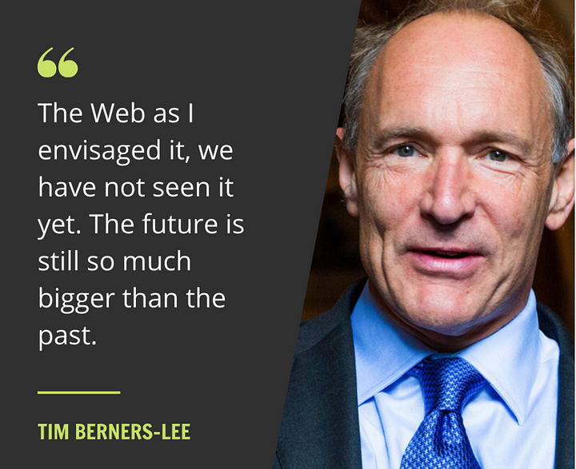

Slide 3
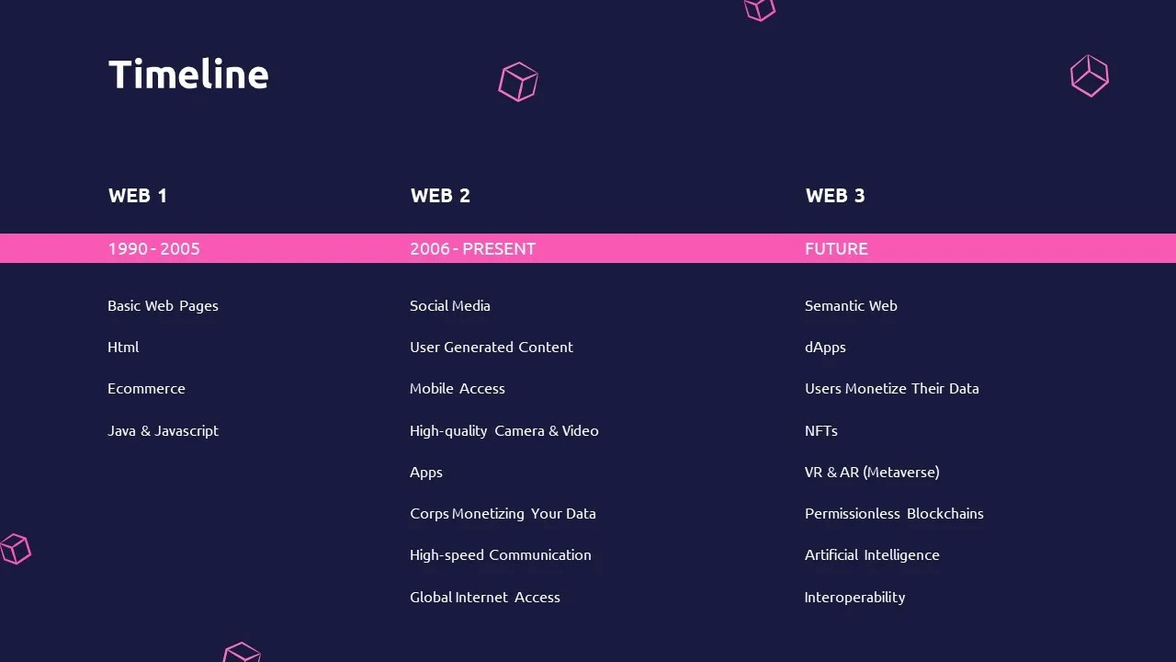

Slide 4
Community Structure
Community Lead
Public Relations Manager
Technical Lead
Developer Lead
Community Outreach Coordinator
Event Planner
Financial Manager
Content Creator

Slide 5
Community Objectives
Collaboration and Learning
Improved Access to Information
Increased Engagement
Personalized Experience
Enhanced Connectivity
Spread the knowledge about future emerging technologies
Encourage students to explore various fields
Provide a platform to find students’ interest

Slide 6
Community Engagement
Workshops and Webinars
Online discussions and forums
Guest Speaker Events
Project-Based Learning
Hackathons

Slide 7
Next Steps
Joining the students to our club
Coordinating with exams
Searching guests
Having an induction session

Slide 8
THANKS!
Do you have any questions?
youremail@freepik.com
+91 620 421 838
yourwebsite.com
Please keep this slide for attribution

